Slide 1
Web with PowerShell
SSgt Michael Wallace

Slide 2
Summary
How your browser works
PowerShell Tools techniques for Websites
Connecting to a website with PowerShell
Manipulating packets with PowerShell
Hands on…Hands on….Hands...on…

Slide 3
Browser Fun
Open IE(I’m using IE 11)
Push F12
Click on the Network TAB
Click green arrow
Go to a website of your choice
Double click the first packet
Analyze exactly what your browser is requesting.

Slide 4
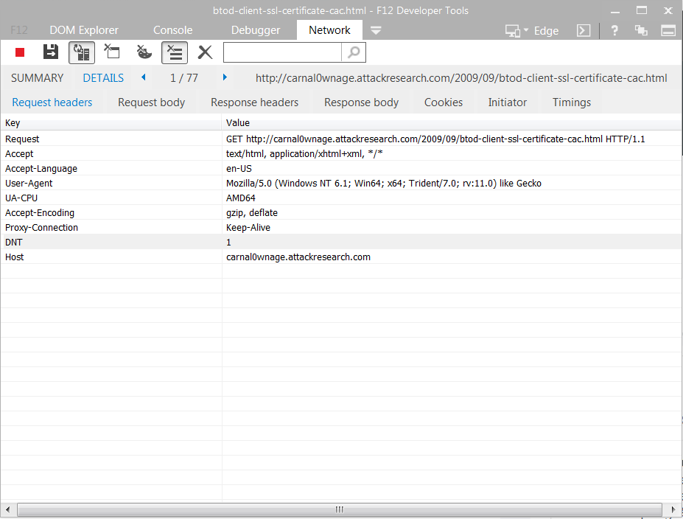
What makes a request?
Notes:
What’s the difference between a Get & a POST request?
What If I want to seem like Firefox? User-Agent: Mozilla/5.0 (Windows NT 6.1; WOW64; rv:39.0) Gecko/20100101 Firefox/39.0

Slide 5
PowerShell Tools we will need.
Windows Powershell ISE (Default on windows)
Powerful Interactive Scripting environment
Invoke-WebRequest
-Uri (TheWebSite)
-Method (Get/Post)
-Body
-SessionVariable
-WebSession
-Credential
-header
Notes:
What is the minium Request information needed?

Slide 6
ISE
Open PowerShell ISE
$r = Invoke-WebRequest -Uri www.google.com -Method Get -SessionVariable sv
What is $r?
Try $r | get-member
How can I use $r?
Try $r.content
Try $r.Forms
Notes:
Basics of connecting to a website
Your method of connecting determines whether you are submitting data or retrieving data
The –SessionVariable option creates a variable containing the session credentials from the website
A –Credential options can be supplied which will accept the PSCredential provided to it.

Slide 7
Practice
Now we’ll practice using these new connections to make requests
How do we connect to a website that requires authentication? (get-help)
Basic Authentication
Forms based

Slide 8
Resources
The Web Application Hacker’s Handbook
Overthewire.org (Natas)

